Slide 1
BIRNAVIRIDAE
Double stranded linear RNA genomes in two components (bi-RNA-viruses).
Baltimore group III viruses
Infectious bursal disease (IBD) virus is the only significant veterinary pathogen

Slide 2
INTRODUCTION
Seven taxonomic families of dsRNA viruses are recognized:
Birnaviridae, Chrysoviridae, Cystoviridae, Hypoviridae, Partitiviridae, Reoviridae, and Totiviridae
Viruses in only two of these families, Birnaviridae and Reoviridae, can infect vertebrates, and those in only one, Reoviridae, can infect mammals.
Birnavirirdae consists of viruses that infect animals (vertebrates, insects, mollusc and crustaceans)

Slide 3
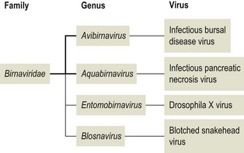
CLASSIFICATION
(infect chicken)
(Baltimore Group III)
(infect fish, crustaceans and molluscs
(infect insects)
(infect fish)

Slide 4
Viral Characteristics
Non-enveloped, approximately 65 nm in diameter, and hexagonal with a single shell having icosahedral symmetry.
The genome consists of two unrelated molecules of linear double-stranded RNA, designated A and B
Larger Segment A ranges from 3.1 to 3.6 kbp in size and contains at least two open reading frames, the largest of which encodes a polyprotein that is processed to form the structural proteins, VP2 and VP3, and a viral protease (designated as VP4 or NS) that autocatalytically cleaves the polyprotein.

Slide 5
VP2 forms the virus capsid
VP2 also contains the principal antigenic sites (type specific Ag) responsible for eliciting neutralizing antibodies.
The inner capsid protein, VP3, contains group-specific antigenic determinants and is associated with the genomic RNA.

Slide 6
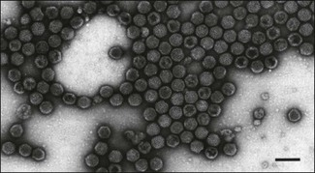
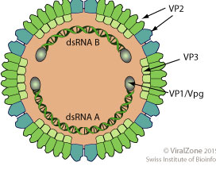

Slide 7
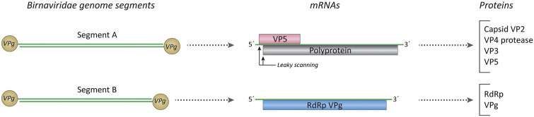
Segment A also encodes a nonstructural protein of (VP5) from an overlapping open reading frame.
Segment B is approximately 2.8–3.3 kbp in size and encodes VP1, which is the RNA dependent RNA polymerase.
VP1 exists as a genome-linked protein (VPg) that circularizes segments A and B by tightly binding to their ends.
Virions are relatively heat stable, and their infectivity is resistant to exposure at pH3 and to ether and chloroform.

Slide 8
Viral replication
Birnaviruses replicate in the cytoplasm without greatly depressing cellular RNA or protein synthesis.
Transcription, defined as the synthesis of viral (+)-strands from a dsRNA template, takes place within viral particles or core particles by a virion-associated RNA-dependent RNA polymerase (transcriptase) that will both serve for translation and/or replication.

Slide 9
The new (+)-strands are generally extruded from the viral particles.
These (+)-strands are then translated to make viral proteins.
It is then the same (+)-strands that are packaged to make new particles or subviral particles.
Once the new particles or cores have formed, (-)-strand synthesis on the (+)- strand template (replication) completes the formation of new dsRNA
Mature virions are released by budding.

Slide 10
Infectious Bursal disease (IBD)
Gumboro disease / Infectious Bursitis and Infectious Avian Nephrosis
Infectious bursal disease was first recognized in 1962 in an outbreak in Gumboro, Delaware; further outbreaks were subsequently referred to as "Gumboro disease."
The most prominent lesion was found in the Bursa of Fabricius, hence the present name of the disease.
A highly contagious disease of young chickens caused by IBDV characterized by immunosuppression and mortality generally at 3 to 6 weeks of age.

Slide 11
The virus attacks the birds lymphoid organs especially the bursa where it affects the B-cells causing immunosuppression.
Affected chickens have reduced antibody response to vaccinations, strong post vaccinal reactions, and increased susceptibility to concurrent or secondary infections.

Slide 12
Role of Bursa in IBD
Bursectomized birds survive otherwise lethal infection without developing clinical signs or disease.
The stage of differentiation of B lymphocytes in the cloacal bursa is crucial in supporting maximum virus replication, as only non-immunoglobulin-bearing B lymphoblasts or IgM-bearing B lymphocytes support virus replication, whereas stem cells and peripheral B cells do not.
The microenvironment of the bursa is important in maintaining the optimal level of differentiation of B lymphocytes to support virus replication.
It is this exquisite virus tropism for only lymphocytes at a certain stage of differentiation that accounts for the age-dependent clinical disease in chickens.

Slide 13
Clinical disease is associated with bird age with the greatest bursal mass, which occurs between 3 and 6 weeks of age. The greatest bursal mass is mostly a result of a large population of maturing IgM-bearing B lymphocytes (lymphoblasts) or pre-B lymphocytes, the main target of infection.
Subclinical disease occurs in chickens infected before three weeks of age. At this age the B-lymphoblast population is smaller and the systemic effects are insufficient for generating clinical signs. And also due to only partial protection by maternal immunity to the infecting strain.
Birds older than 6 weeks rarely develop signs of disease, although they produce antibodies to the virus.

Slide 14
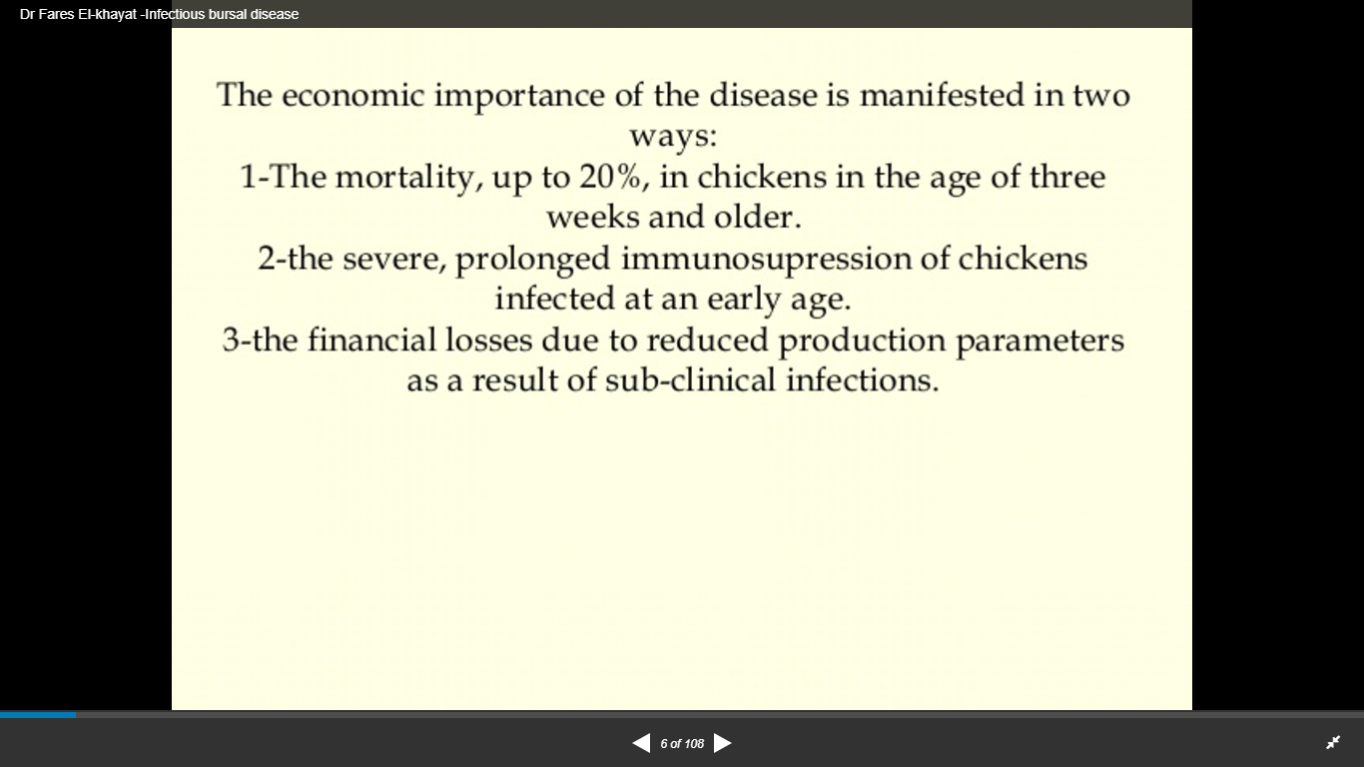

Slide 15
PATHO/SERO TYPES OF IBDV :
Serotype-1. pathogenic with 3 Sub types
(i) Standard or classical serotype –1 Moderate mortality and Immunosuppression.
(ii) Variant serotype-1 No mortality and high Immunosuppression. First recognized in the US in the mid-1980s in flocks that had been vaccinated with classical strain vaccines. These antigenic variants are highly immunosuppressive in young chicks, causing rapid bursal atrophy without clinical signs of disease.
(iii) Hyper or Very virulent serotype-1 High mortality and high Immunosuppression. first reported in Europe and Asia in the late 1980s. These vvIBDV strains are similar antigenically to classical serotype 1 strains but have caused disease even in the presence of maternal antibody induced by classical vaccine strains.
Serotype-2. apathogenic ;Found only in Turkey.

Slide 16
TRANSMISSION
The extreme resistance of the virus to the outside environment enhances the potential for indirect transmission.
Via Ingestion ( horizontally through contaminated food and water )
Mechanical transmission via people , animals ,vehicles and equipments when transferred from diseased flock to healthy one .
May be via the conjunctiva or respiratory tract, with an incubation period of 2-3 days.
The infected birds shed virus for 14 days in their faeces. Feed, water, and poultry house litter become contaminated.

Slide 17
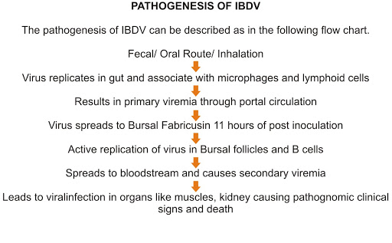

Slide 18
CLINICAL SIGNS
When infectious bursal disease virus is newly introduced into a flock, morbidity approaches 100% and mortality may be up to 90%.
Infectious bursal disease follows one of two courses, depending on the age at which chickens , breed and virulence of field virus
1-clinical form
2-subclinical form

Slide 19
CLINICAL FORM
The clinical form of IBD usually occurs in chickens from 3 to 6 weeks of age .
sudden onset of mortality rate and poor performance
a rapid drop in feed and water consumption
mucoid (slimy) diarrhea with soiling of the vent feathers and dehydration.
depression,ruffled feathers and closed eyes
Many birds may be reluctant to move with a tendency to sit
picking at own vent and sleeping with beak touching the floor
poor FCR so variability in body weight .
Affected chickens experience a transient immunosuppression.

Slide 20
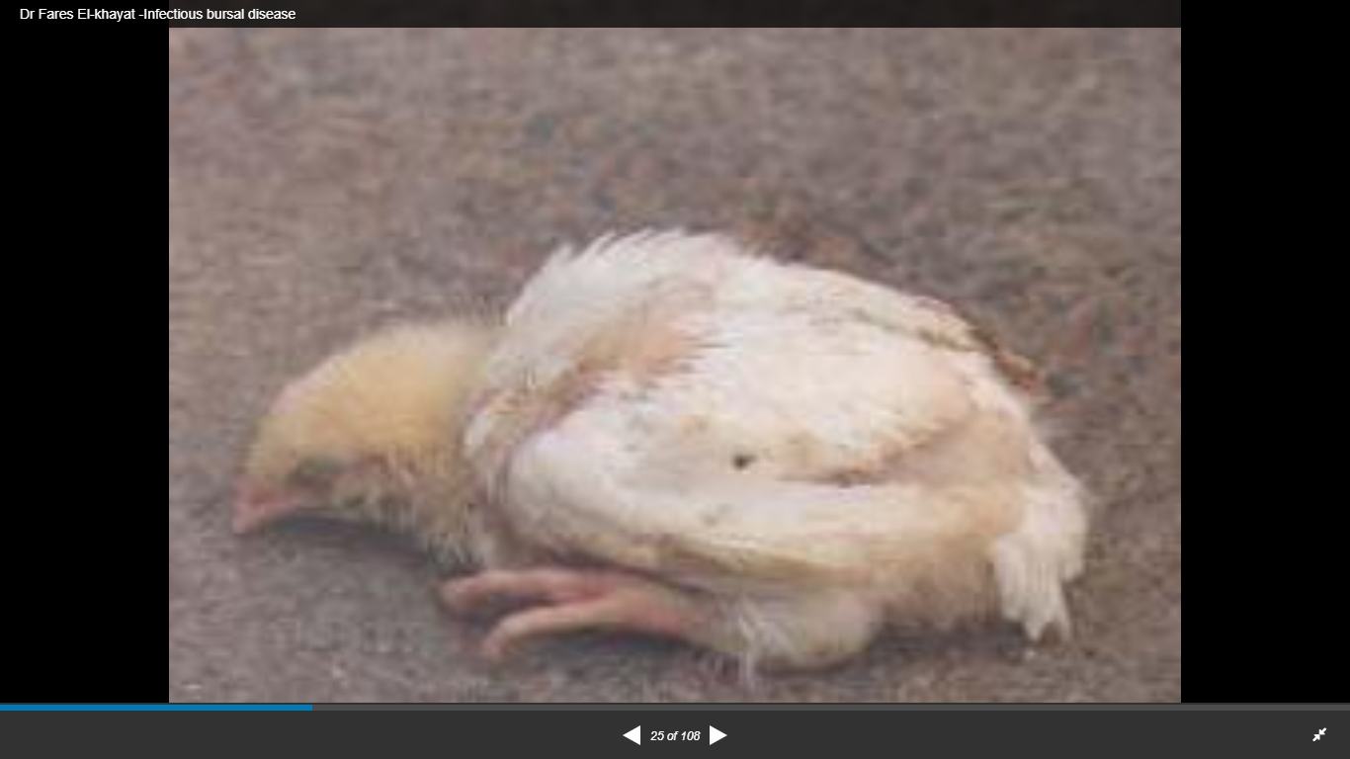
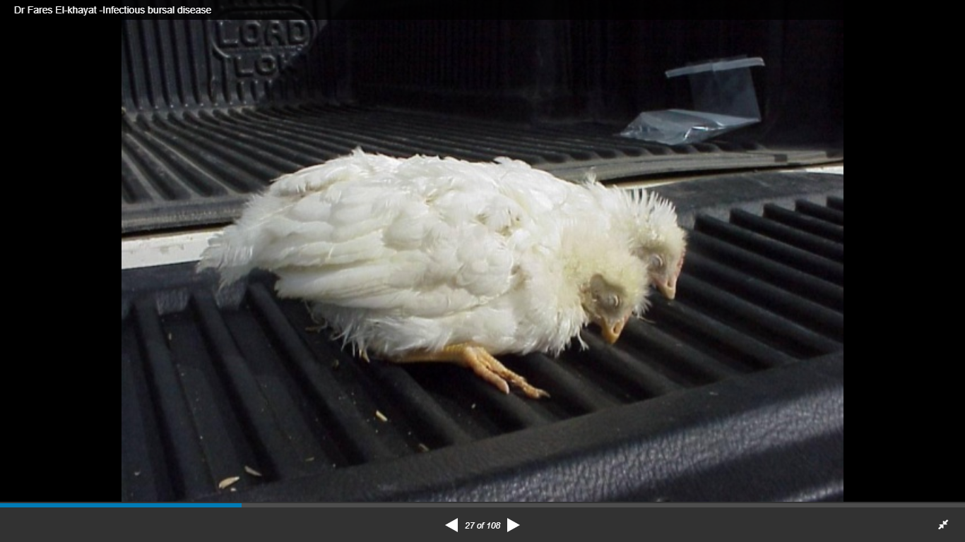

Slide 21
SUBCLINICAL FORM
The subclinical form of the disease occurs in chickens less than 3 weeks of age.
Chickens present no clinical signs of disease, but experience permanent and severe immunosuppression
Early subclinical infections are the most important form of the disease because of economic losses.
Chickens immunosuppressed by early IBDV infections do not respond well to vaccination and are predisposed to infections with normally nonpathogenic viruses and bacteria.

Slide 22
PM LESIONS
Oedematous bursa (may be slightly enlarged, normal size or reduced in size depending on the stage), may have haemorrhages, rapidly proceeds to atrophy. Five days after infection, the BF diminishes in size rapidly .
Haemorrhages in skeletal muscle (especially on thighs) and junction of the proventriculus and gizzard because the IBD virus interferes with the normal blood clotting mechanism.
Swollen kidneys with urates. Such lesions probably result form severe dehydration, not direct viral damage.
Chickens that have recovered from IBDV infections have small, atrophied, cloacal bursas due to the destruction and lack of regeneration of the bursal follicles.

Slide 23
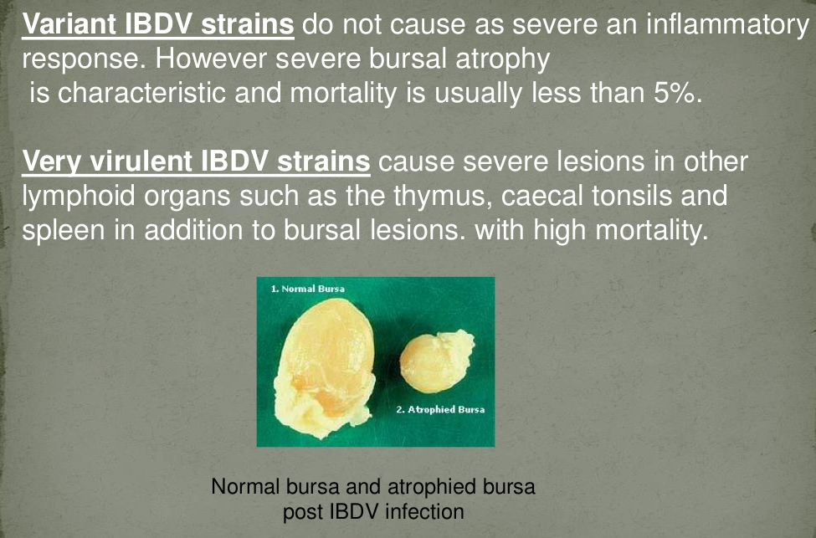

Slide 24
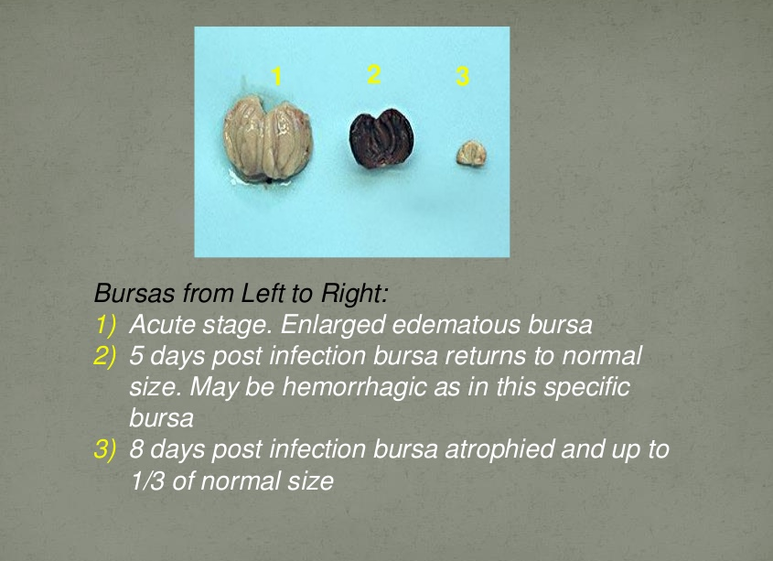

Slide 25
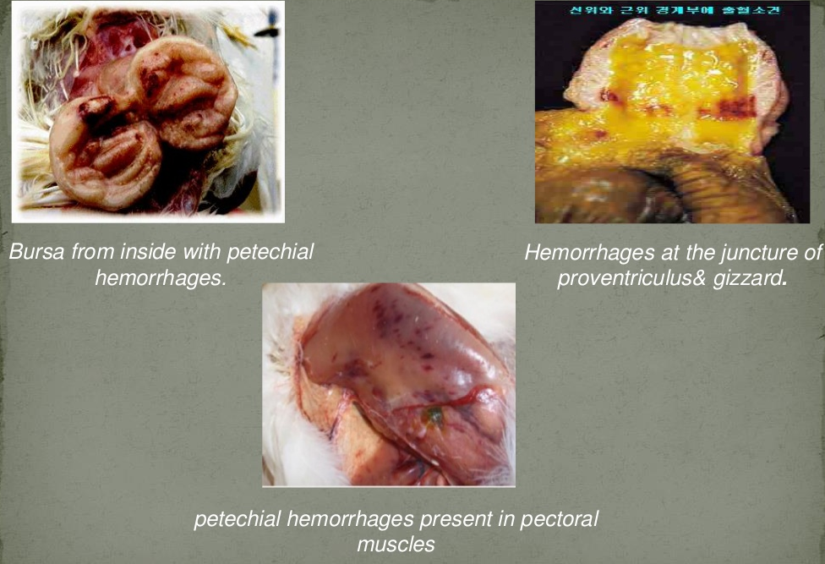

Slide 26
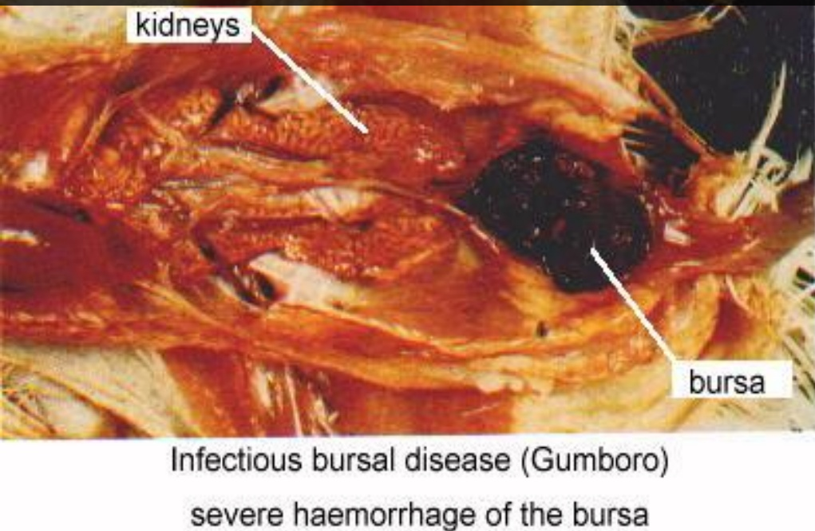
Kidneys swollen and pale

Slide 27
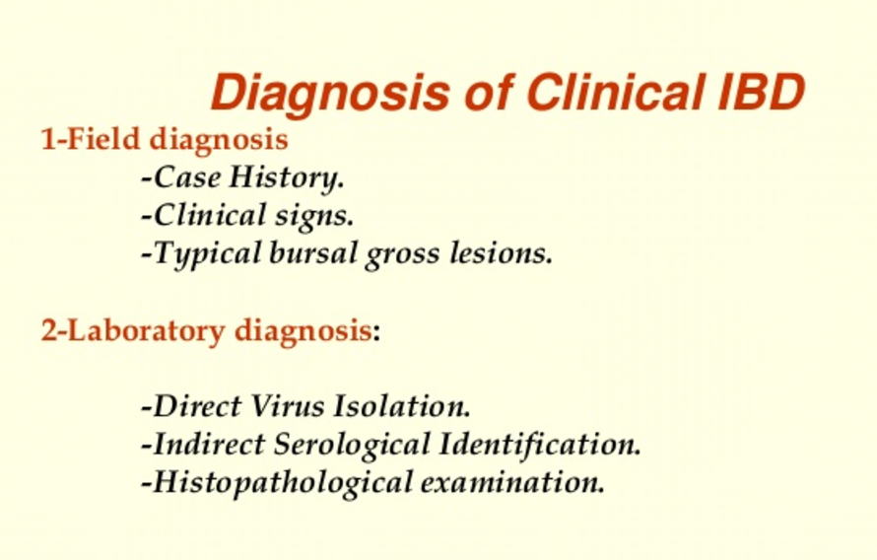

Slide 28
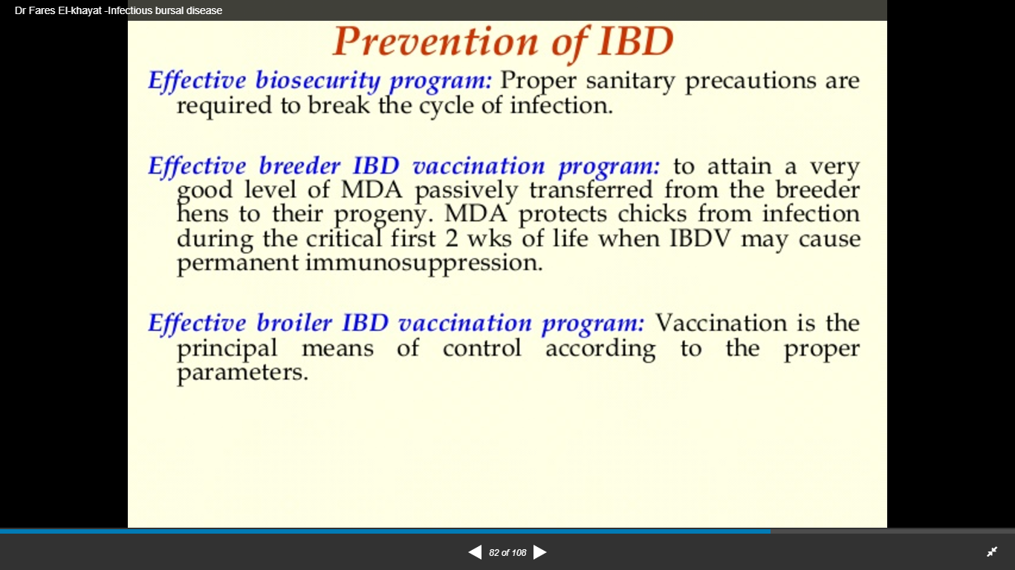

Slide 29
VACCINATION
Vaccines need to be selected based on the types of viruses present in the area.
The timing of broiler vaccination depends on the level of maternal antibody present in the chicks.
High levels of maternal antibody at the time of vaccination will neutralize the vaccine virus. Thus, only a limited active immune response results and chickens will be susceptible to disease as maternal titers decrease.
If low levels of maternal IBD titres are present in the chicks, vaccination may not be effective on farms contaminated with virulent field virus.
vaccinating the chicks too early and too late will produce a negative effect and will not protect the birds.

Slide 30
VACCINES
Three categories of vaccines, based on their pathogenicity, have been described:
1) mild –for breeder flocks
2) intermediate – for broilers and pullets
3) intermediate plus (hot strain )
The intermediate type IBD vaccines are most commonly used. These vaccines can stimulate the broiler to produce antibodies earlier than the mild-type vaccines, without significant damage to the BF as may occur with the virulent type vaccines.

Slide 31
Family Togaviridae (small, enveloped viruses with single-stranded positive-sense RNA genomes)

Slide 32
General characteristics
Members in the family possess a lipid envelope (or cloak: “toga”) surrounding an icosahedral capsid.
Baltimore group IV
Family includes Alphavirus genus which includes a large number of species that are mostly mosquito-borne and pathogenic in their vertebrate hosts

Slide 33
Before April 2019 the family also contained the genus Rubivirus that has now been moved to the family Matonaviridae.
Rubiviruses differ from alphaviruses in their mode of transmission, genome organization, virion structure and sequence relationships.
Rubivirus genus is exclusively human pathogen i.e. Rubella virus

Slide 34
Alphavirus
The alphaviruses were originally described as Group A arboviruses based upon their antigenic cross-relationships.
Transmitted to humans through the mosquito species Aedes aegypti and Aedes albopictus, where they cause various diseases and can be broadly divided into arthritogenic and encephalitogenic.

Slide 35
Old World alphaviruses such as chikungunya virus (CHIKV), o’nyong’nyong virus (ONNV), and sindbis virus (SINV) are arthritogenic and commonly cause febrile illness accompanied by rash, polyarthralgia and chronic arthritis .
Infection with New World alphaviruses such as Eastern equine encephalitis (EEEV) and Venezuelan equine encephalitis virus (VEEV), which are less prevalent in humans, are mostly associated with neurological disease. Cause sleeping sickness in horses.

Slide 36
VIRION PROPERTIES
Spherical and uniform in appearance
Enveloped and 70 nm in diameter
The particle consists of a nucleocapsid core surrounded by a lipid bilayer that is embedded with glycoprotein spikes or peplomers.
The lipid bilayer is host-derived from the site of budding. Alphaviruses bud from the plasma membrane although, in arthropods, budding into internal vesicles has also been observed

Slide 37
The peplomers are arranged as 80 trimers, each a heterodimer composed of two glycoproteins, E1 and E2.
Each spike is composed of three E1-E2 heterodimers.
The genome is a single-strand of positive-sense RNA that is capped and has a poly-A tail.
The 5' two-thirds of the genome encodes nonstructural proteins; the 3' one-third is not translated from genomic RNA itself but is expressed as a 26S subgenomic mRNA molecule, which is transcribed from a full-length, negative-sense intermediate.

Slide 38
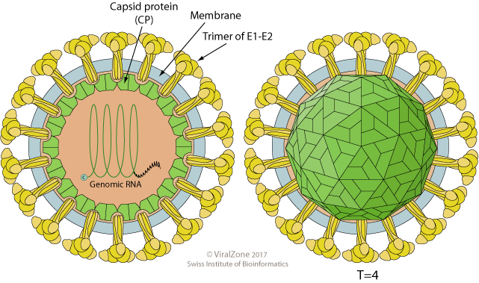

Slide 39
The portion (49S RNA) coding for the nonstructural proteins is translated into a polyprotein, which is cleaved into four NS proteins. Two of these form the RNA polymerase, which transcribes a full-length, negative-sense complementary RNA from the genomic RNA template.
Two positive-sense RNA species are transcribed from this complementary RNA: (1) virion RNA and
(2) a 26S subgenomic mRNA which is identical to the 3' one-third of the virion RNA, it is translated into a polyprotein that is then cleaved to form the viral structural proteins El, E2, E3, 6K, and C.

Slide 40
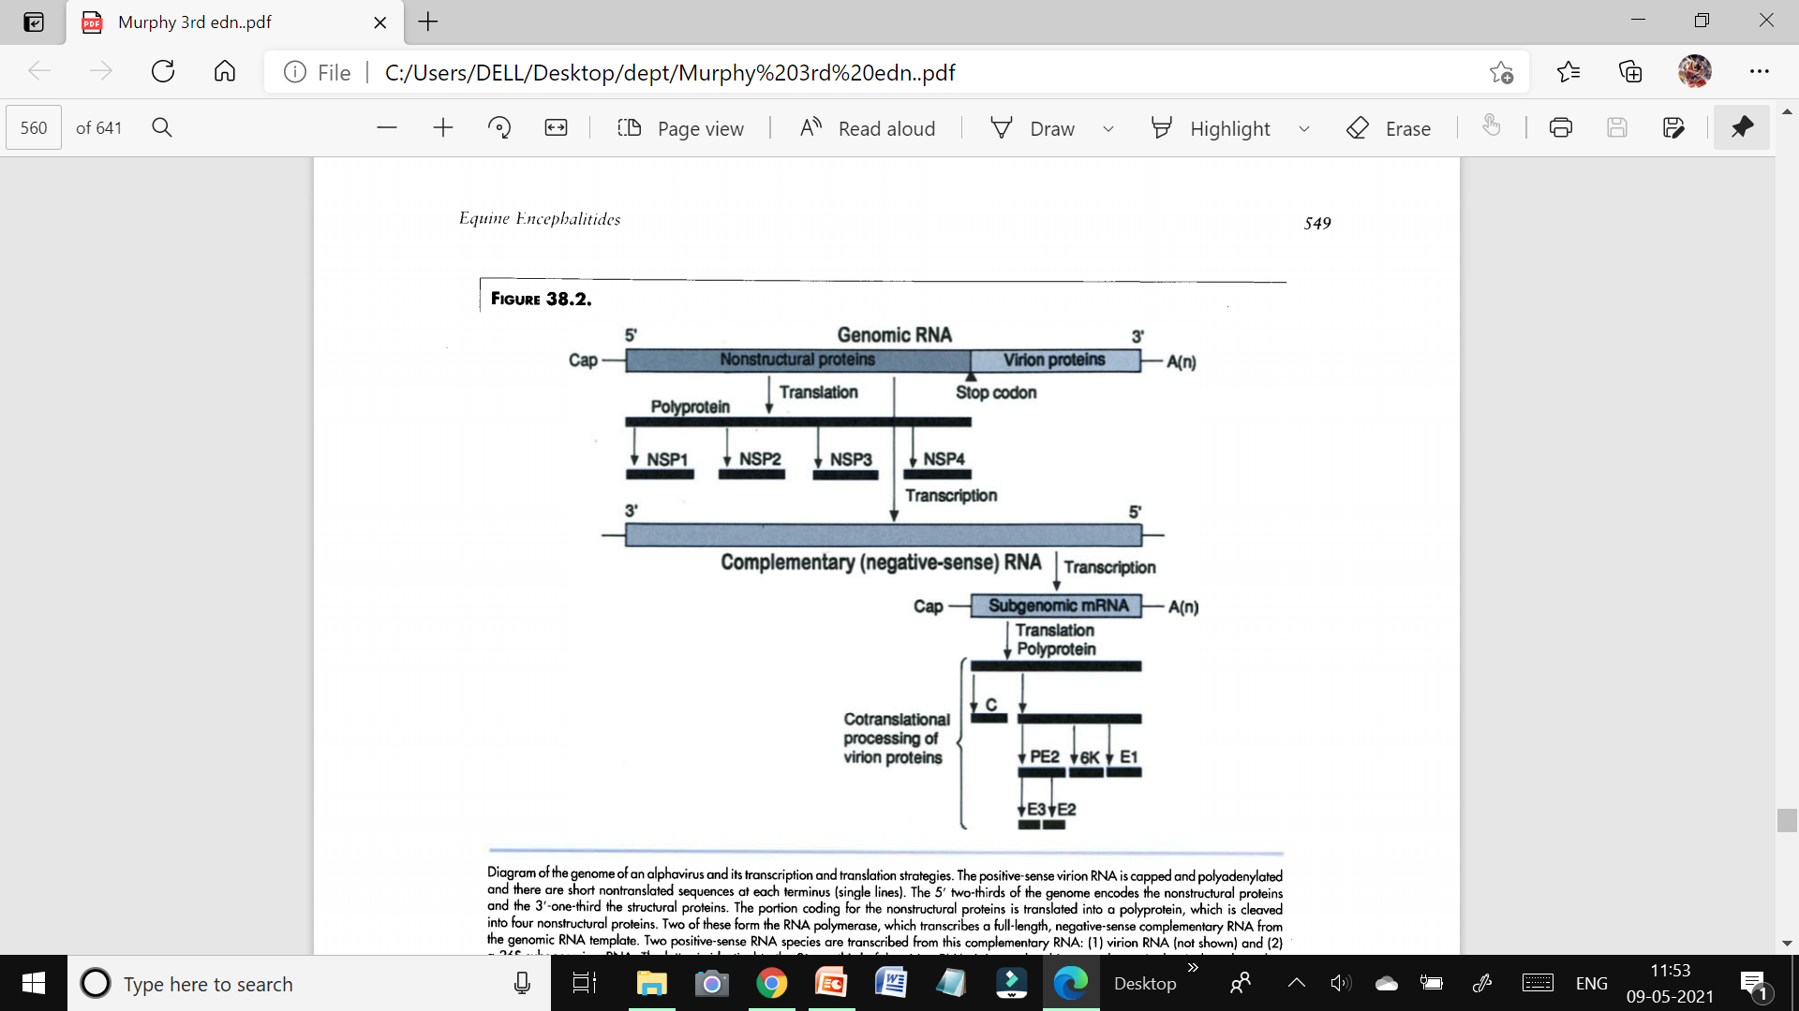

Slide 41
Replication
CYTOPLASMIC
Viral attachment to the host cell first involves interaction between the viral E1 glycoprotein with phospholipid receptors on the cell surface; entry involves binding of viral E2 glycoprotein to cellular proteins. This is followed by receptor-mediated endocytosis.
Fusion of virus membrane with host endosomal membrane.
RNA genome is released into the cytoplasm.
The positive-sense genomic ssRNA is translated into a polyprotein, which is cleaved into non-structural proteins necessary for RNA synthesis (replication and transcription).

Slide 42
Replication takes place in cytoplasmic viral factories at the surface of endosomes.
A dsRNA genome is synthesized from the genomic ssRNA(+).
The dsRNA genome is transcribed/replicated thereby providing viral mRNAs/new ssRNA(+) genomes.
Expression of the subgenomic RNA (sgRNA) gives rise to the structural proteins.
Nucleocapsids are assembled in the cytoplasm, upon endoplasmic reticulum membranes
The capsid is enveloped by budding at the plasma membrane where the virion exits the cell.

Slide 43
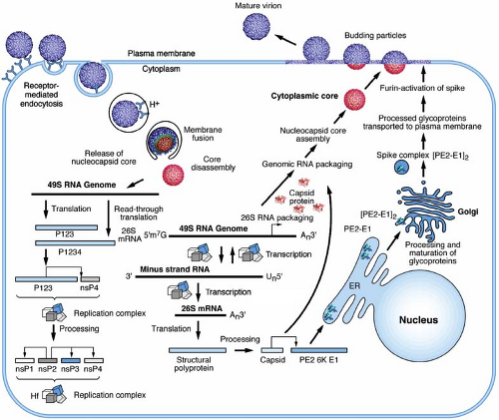

Slide 44
Physiochemical and physical properties
The viruses are not very stable in the environment and are inactivated easily by common disinfectants.
Virions can be physically denatured by treating with various chemicals including urea, formaldehyde, beta-propiolactone , detergents, and acids.
Infectivity is also decreased by heat inactivation, by exposure to low pH in the absence of lipid vesicles and exposure to ultraviolet light .

Slide 45
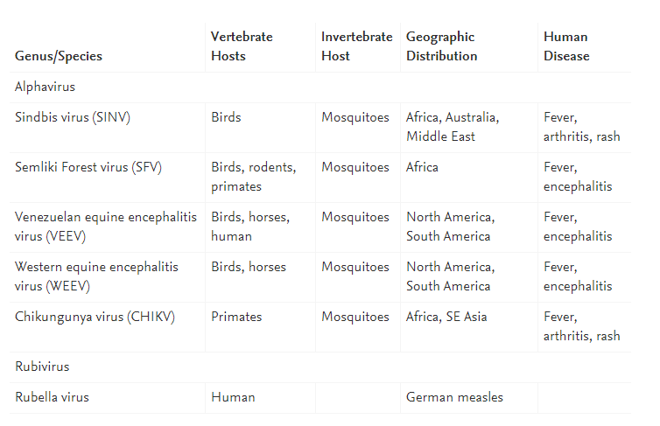
DISEASES IN DOMESTIC ANIMALS AND ZOONOTIC DISEASES OF HUMANS

Slide 46
Epidemiology
The Alphaviral equine encephalitides, including Eastern equine encephalitis (EEE), Venezuelan equine encephalitis (VEE) and western equine encephalitis (WEE), are arthropod-borne (mosquito-borne) diseases of horses that occur in the Western Hemisphere.
Although related, the three viruses are genetically and antigenically distinct.
OIE List B disease
Serious zoonoses.
EEE and WEE have caused outbreaks of disease in poultry and other farmed bird species.
The three viruses are found in North, Central and South America, with WEE being the most widely distributed — from south-west Canada to most of South America east of the Andes.

Slide 47
Transmission
Mosquitoes (Culiseta melanura, Aedes vexans, Culiseta tarsalis, Culicoides spp, Culex spp.) are responsible for transmitting all three viruses.
The natural cycle for EEE and WEE viruses is between birds and/or small mammals and mosquitoes.
Small outbreaks or sporadic cases occur in humans and horses, which are generally regarded as ‘dead end’ hosts.
With VEE, the natural cycle is poorly understood, but is believed to involve culicine mosquitoes and forest rodents.

Slide 48
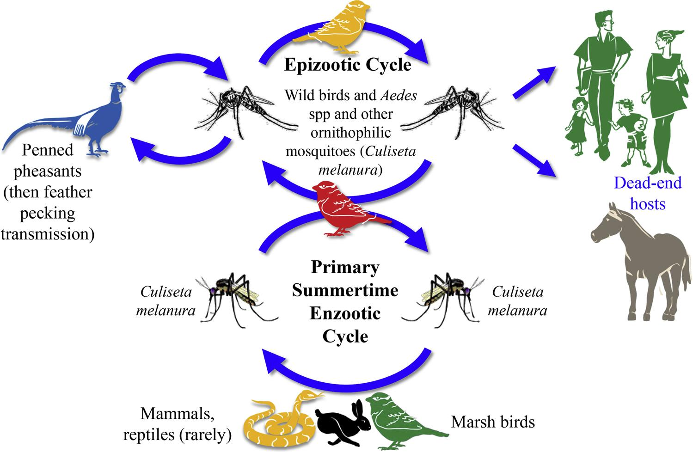
TRANSMISSION OF EEE

Slide 49
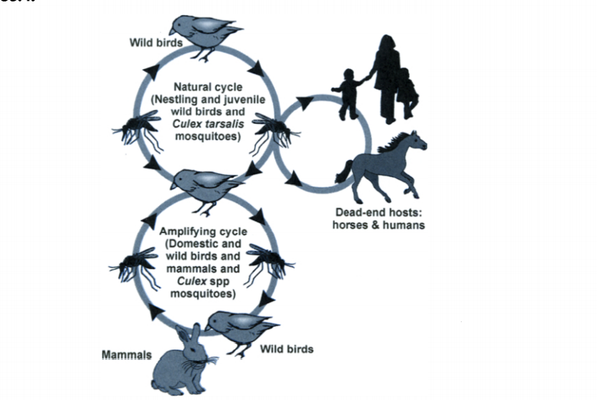
TRANSMISSION OF WEE

Slide 50
Venezuelan Equine Encephalomyelitis Viruses
The Venezuelan equine encephalomyelitis (VEE) complex contains at least 8 viral subtypes; these viruses are divided into epizootic and enzootic groups.
The epizootic subtypes are responsible for most epidemics. They are highly pathogenic for horses and also cause illness in humans.
Enzootic (sylvatic) subtypes are generally found in limited geographic areas, where they occur in natural cycles between rodents and mosquitoes. The enzootic subtypes can cause human disease. They are usually nonpathogenic for horses; however, in 1993 an enzootic variant was responsible for an outbreak of VEE among horses in Mexico.

Slide 51
Pathogenesis
Following viral entry via the bite of a mosquito vector, viral replication occurs in cells near the entry site and/or in regional lymph nodes.
The resulting primary viremia allows virus to invade specific extraneural tissues where further viral replication provides the high titer secondary viremia, which is key to the infection of further mosquitoes and key to the invasion of the central nervous system.
The viruses replicate primarily in muscle, connective tissue, and the reticuloendothelial system (especially dendritic cells and lymphoid cells).

Slide 52
In the central nervous system, infection involves neurons, the choroid plexus, ependyma, and meninges.
Venezuelan equine encephalitis virus also infects the upper respiratory tract, pancreas, and liver.
Incubation Period The incubation period for WEE or EEE is 5 to 14 days. The clinical signs of VEE are usually seen 1 to 5 days after infection.

Slide 53
Clinical findings
Infection of horses with Eastern, Western, or Venezuelan equine encephalitis viruses may be subclinical or may present with only fever, anorexia, and depression.
Progressive systemic disease leading to death with only minor neurologic manifestations is most common in VEE.
Neurologic disease, which is most severe in eastern equine encephalitis, presents after a 5-day incubation period with fever and signs of drowsiness and incoordination.

Slide 54
The disease progresses rapidly to profound depression (typically with wide stance, hanging head, drooping ears, flaccid lips, irregular gait, wandering) and clear signs of encephalitis (impaired vision, photophobia, inability to swallow and other reflex impairment, circling, yawning, grinding of teeth).
Constant head pressing against a corner of the stall or fence is a typical presentation.
In terminal stages of disease, there is an inability to rise, paralysis, and occasionally convulsions.
In horses, the case-fatality rate of EEE virus infection is 50-90%, WEE virus infection is about 20-40%, and VEE virus (epidemic types) infection is about 50-80%.

Slide 55
Venezuelan Equine Encephalomyelitis in Horses
The enzootic subtypes usually infect horses subclinically.
The epizootic subtypes can cause asymptomatic infections or two clinical syndromes.
One syndrome resembles EEE and WEE; in this form, a febrile prodrome is followed by neurologic signs and sometimes diarrhea and colic. Death can occur within hours after the onset of neurologic signs or after protracted disease. Animals that recover may have permanent neurologic signs.
The second form of VEE is a generalized acute febrile disease without neurologic signs. The symptoms may include fever, weakness, depression, anorexia, colic and diarrhea.

Slide 56
Necropsy findings
Dead animals- lesions are confined to brain mainly.
There is neuronal damage and accumulation of leukocytes in perivascular area.
Liquefactive necrosis and haemorrhages are also seen in the cerebral cortex in cases of VEE.
Necrotic foci are sometimes seen in the pancreas, liver and heart of horses with VEE.

Slide 57
Diagnosis
History and clinical signs: History of presence of high insect vectors and central nervous system involvement may give some idea about the disease.
Blood examination: In VEE, leukopenia occurs while in EEE or WEE, it is not a consistent finding.
Isolation of the virus: During the early febrile period, virus can be isolated from the blood sample of suspected animal.
For isolation of virus, brain tissue of animal that died of disease should be collected as early as possible and the brain suspension is inoculated into suckling mice.
The virus can also be grown on embryonated chicken eggs and tissue cultures as well as established cell lines.

Slide 58
Serological tests
The disease can be diagnosed by haemagglutination inhibition, serum neutralization and complement fixation tests.
The ELISA is recognized as a rapid and sensitive test.
The disease can also be diagnosed quickly by fluorescent antibody test on fresh or frozen brain tissue.

Slide 59
Control / vaccines
Inactivated and attenuated vaccines are available either monovalent or polyvalent for each of the viruses.
In endemic areas, annual vaccination is recommended.
Vaccination programs should be supported by mosquito control programs where practicable.

Slide 60
Feature | Eastern Equine Encephalitis Virus (EEEV) | Western Equine Encephalitis Virus (WEEV) | Venezuelan Equine Encephalitis Virus (VEEV)
Geographic Distribution | Eastern USA, Gulf coast, Caribbean, Central & South America | Western USA, Canada, Mexico, South America | Central and South America, Mexico, southern USA
Vector (Mosquito) | Culiseta melanura (bird-mosquito cycle); other bridge mosquitoes (e.g., Aedes) infect horses/humans | Culex tarsalis mainly | Culex and Aedes spp.; efficient horse-mosquito-horse transmission
Reservoir Host | Wild birds | Birds and small mammals | Rodents (especially forest-dwelling rodents)
Dead-End Hosts | Humans and horses | Humans and horses | Humans (in epizootics); horses are amplifying hosts
Enzootic vs Epizootic Cycle | Enzootic with occasional epizootics | Usually epizootic | Both enzootic and epizootic forms

Slide 61
Amplifying Host | Birds | Birds | Horses and rodents (esp. in epizootics)
Case Fatality Rate in Humans | High (30–70%) | Low (3–7%) | Moderate (1–35%), depending on strain
Case Fatality Rate in Horses | 90% | ~20–50% | 50–80%
Clinical Signs in Horses | Fever, anorexia, ataxia, head pressing, seizures, coma | Fever, depression, incoordination, mild neurologic signs | Similar neurologic signs with high viremia
Pathogenesis | Severe encephalitis, vascular damage | Less severe encephalitis | Viremia and encephalitis
Human Disease | Rare but often severe and fatal | Mild or asymptomatic to moderate encephalitis | Febrile illness to severe encephalitis

